Slide 1
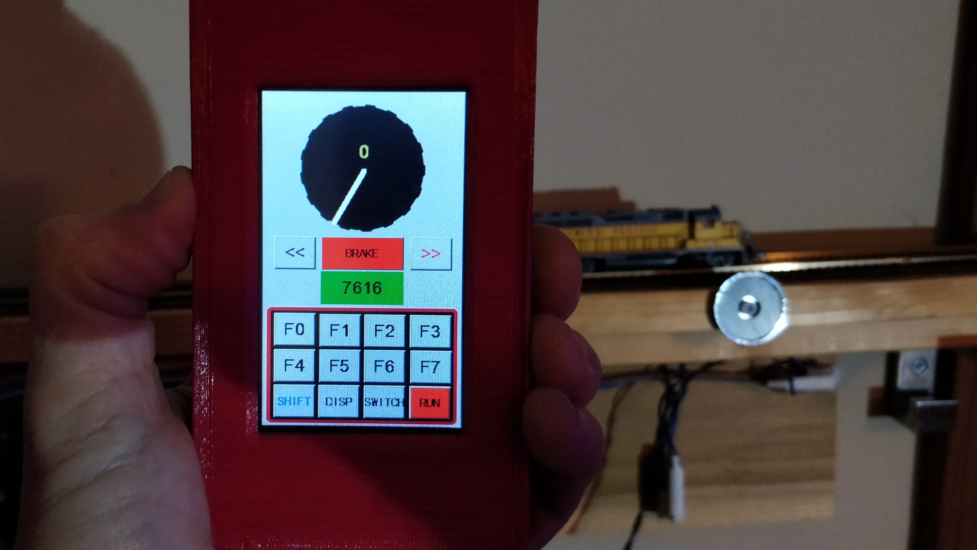
LocoNet
Wifi
Throttle

Slide 2
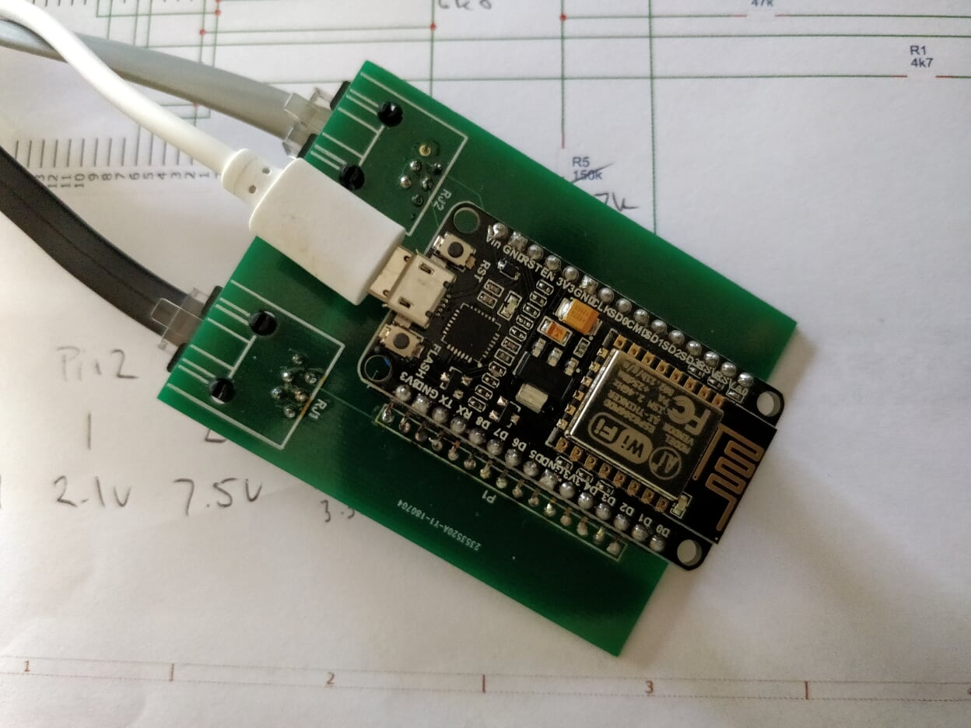

Slide 3
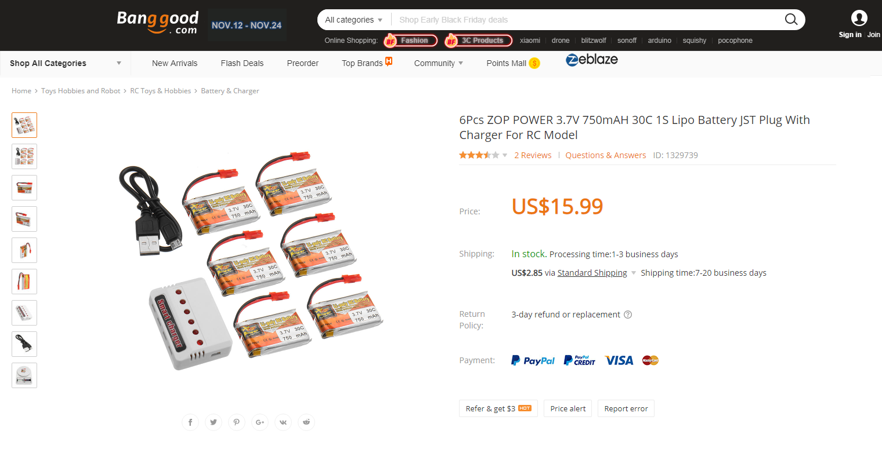

Slide 4
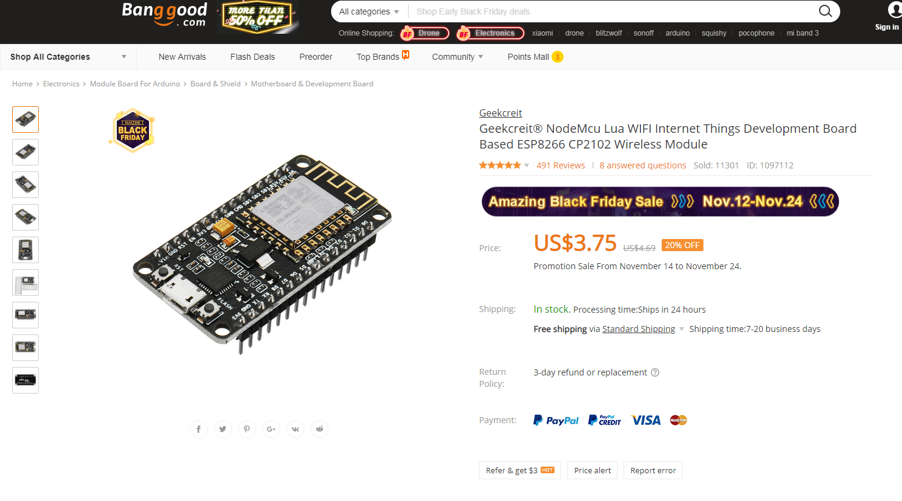

Slide 5
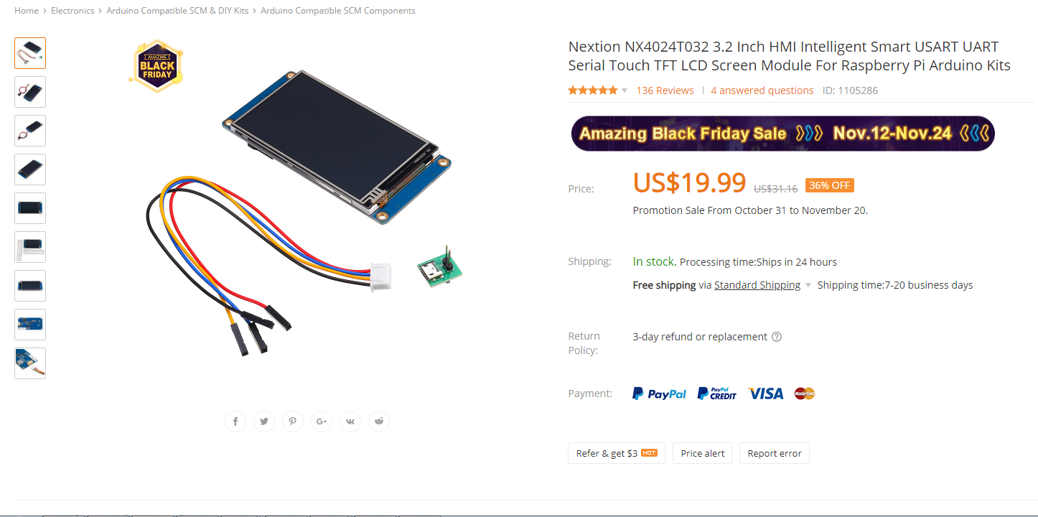

Slide 6
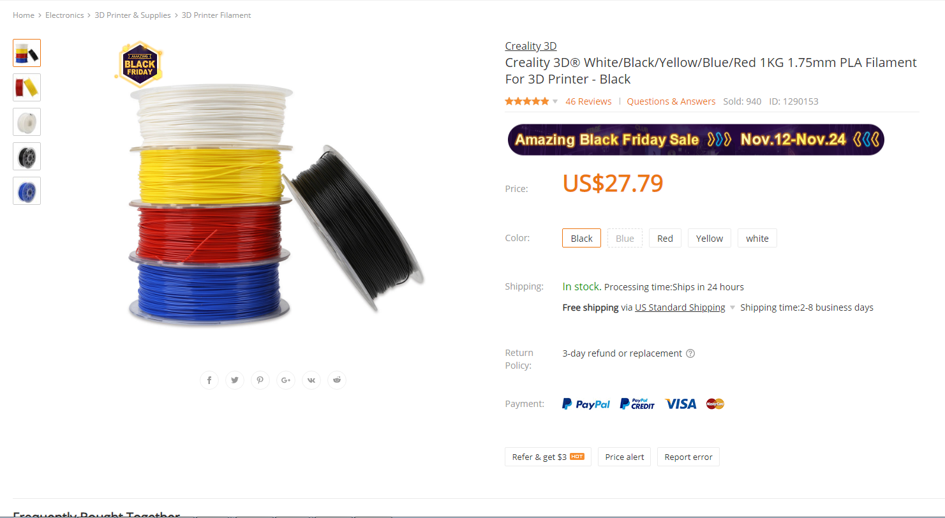

Slide 7
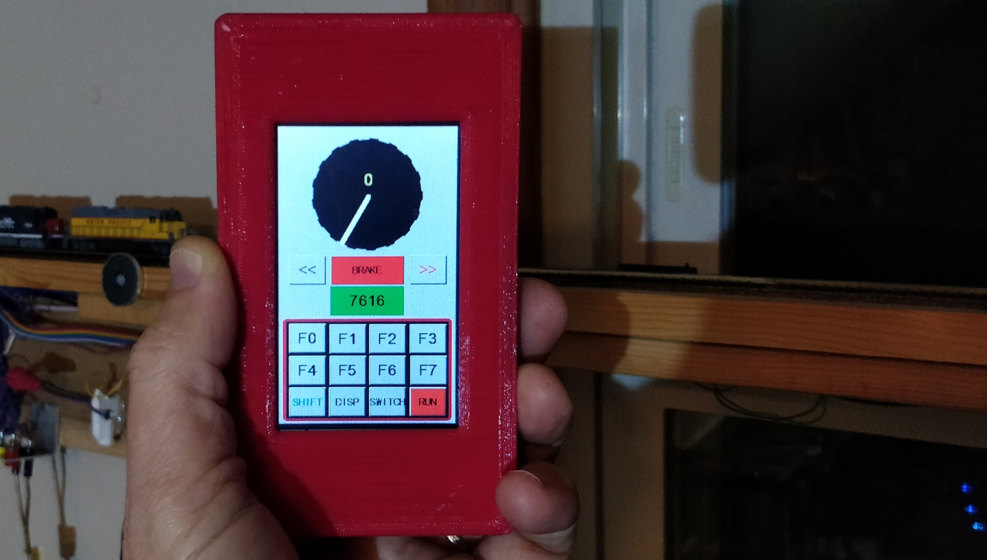
Touch Display $20.00
Battery $ 3.00
ESP8266 $ 4.00
Filament $ 2.50
Total Material Cost $29.50

Slide 8
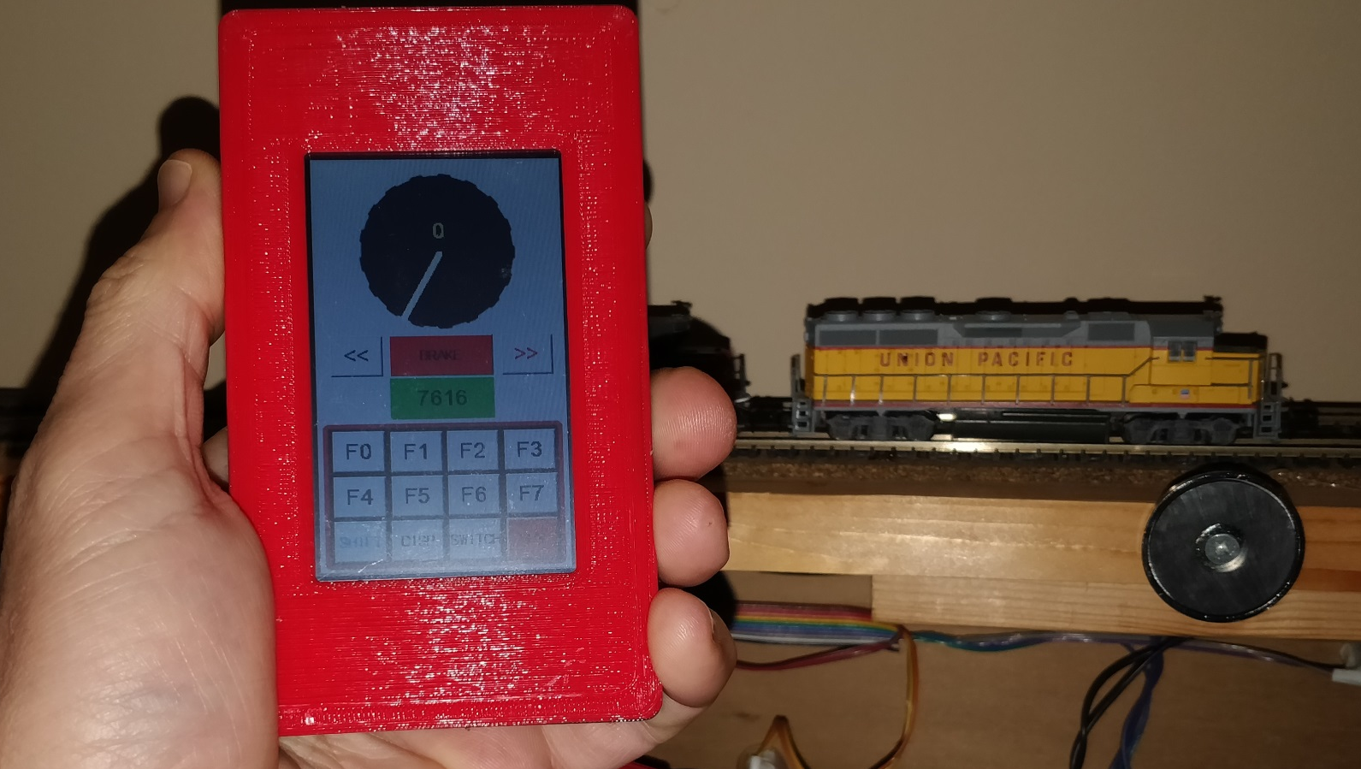

Slide 9


Slide 11
Jump to your topic of interest: @ Time
Introduction Nextion Display 1:44
Making the Throttle Hardware 3:36
Throttle Main Display 5:47
Loco Control Demo 8:41
Switch Control Demo 11:08
CTC Demo 12:36
Summary 14:05
Does this all make sense? – Review 15:15

Slide 12
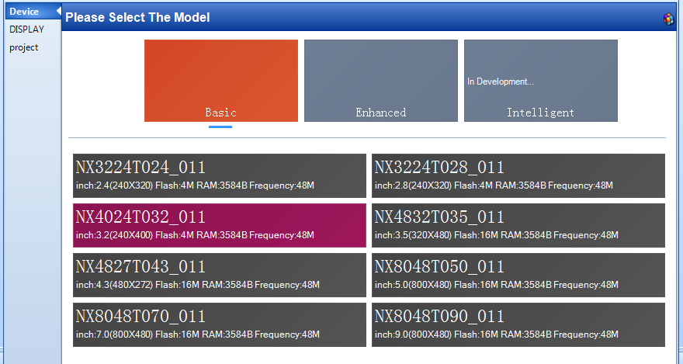

Slide 13
NodeMCU
ESP8266
Controller
(Arduino IDE)
Nextion
Display 3.2”
240 x 400 pixel
Serial Comm 9600 Baud

Slide 14
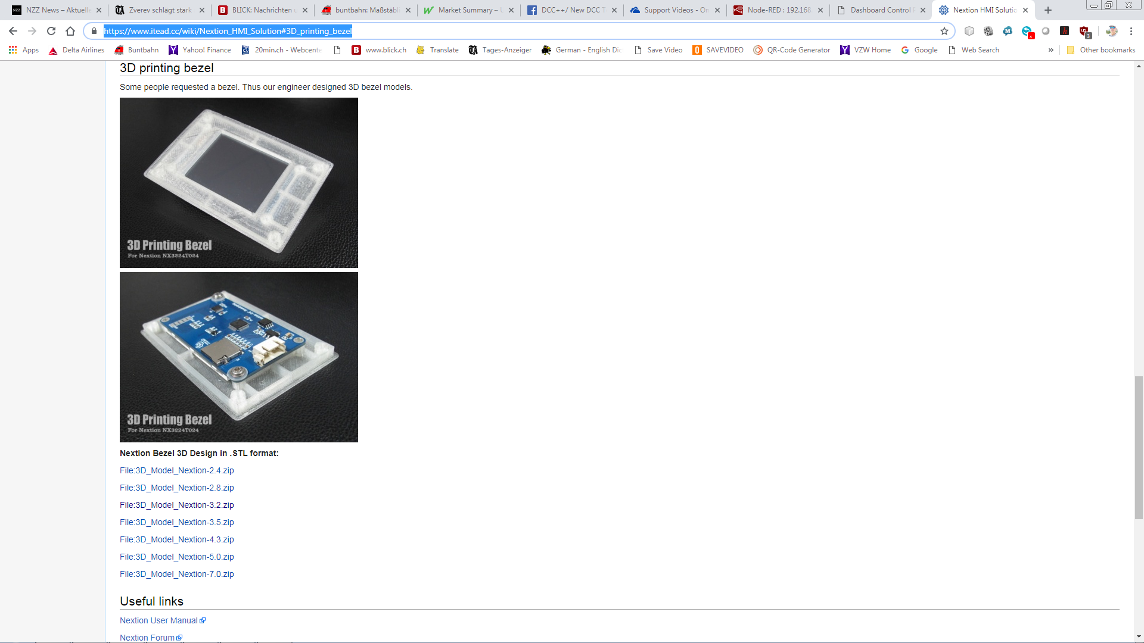

Slide 15
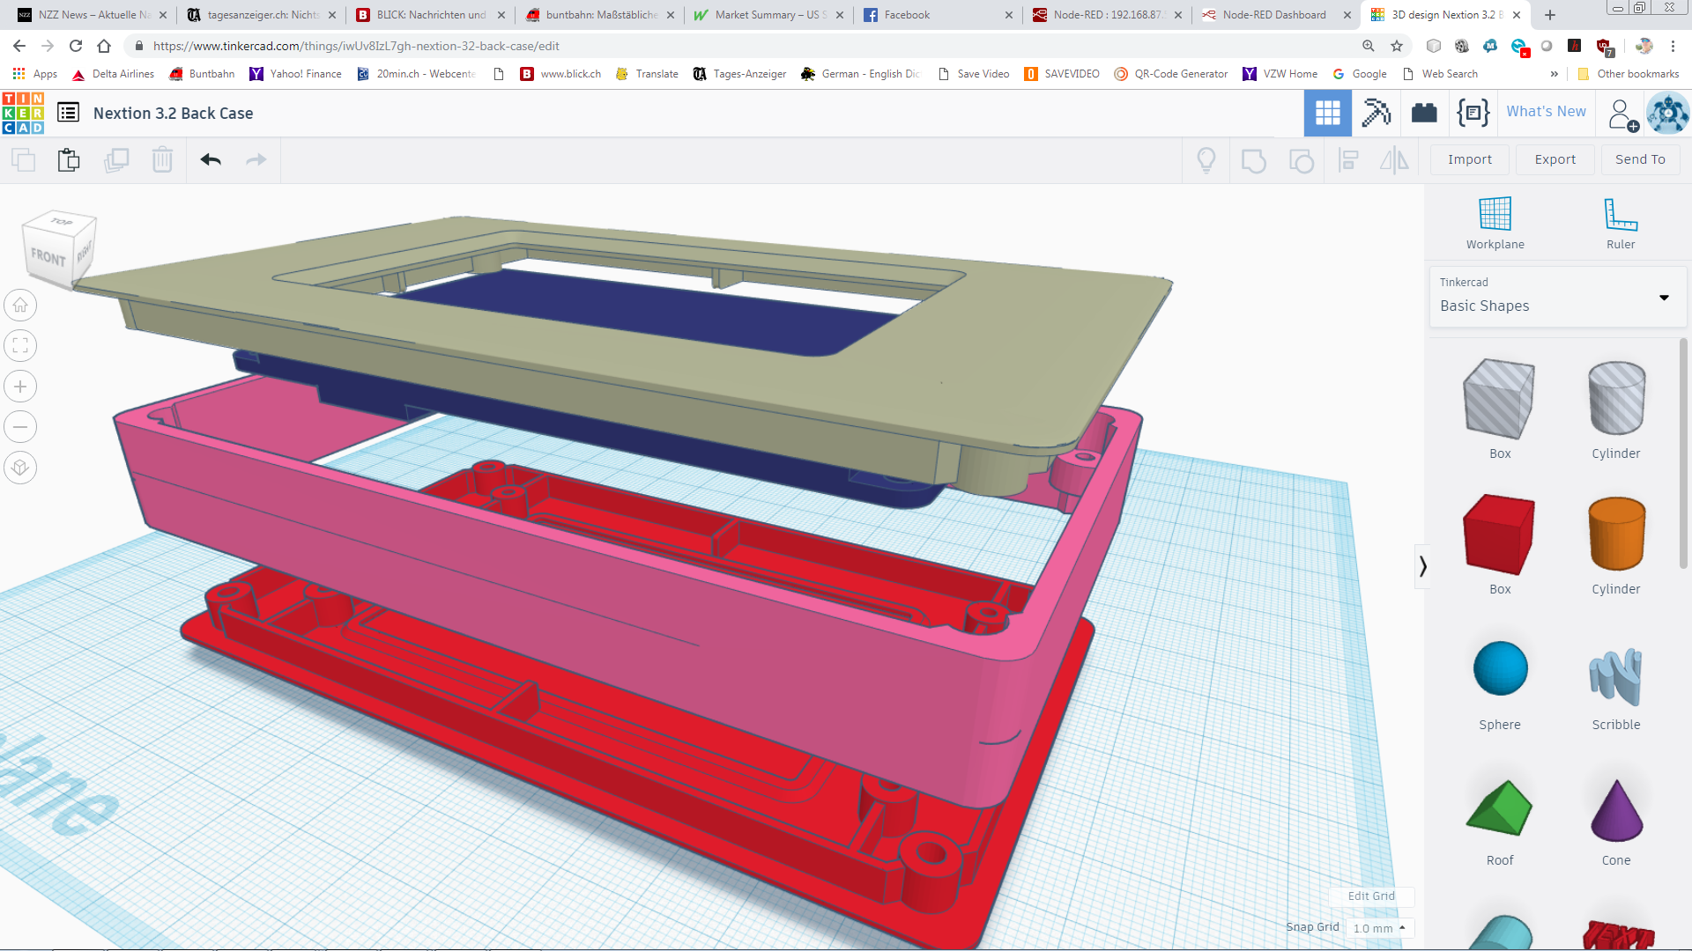

Slide 16
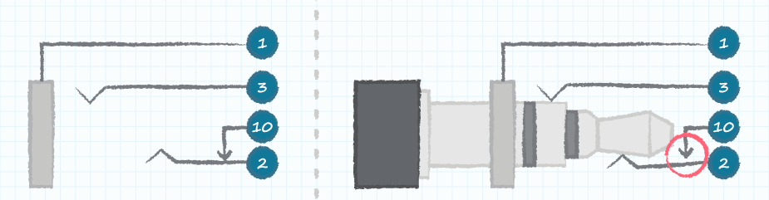
Speaker Connector with Plug inserted
Charger Minus
Charger Plus
Connections:
1 ESP GND, Battery Minus
2 Battery Plus
10 ESP Vin
Plugging in the charger switches OFF the ESP, unplugging starts the throttle
For long time storage, keep plugged but disconnected from charger

Slide 17
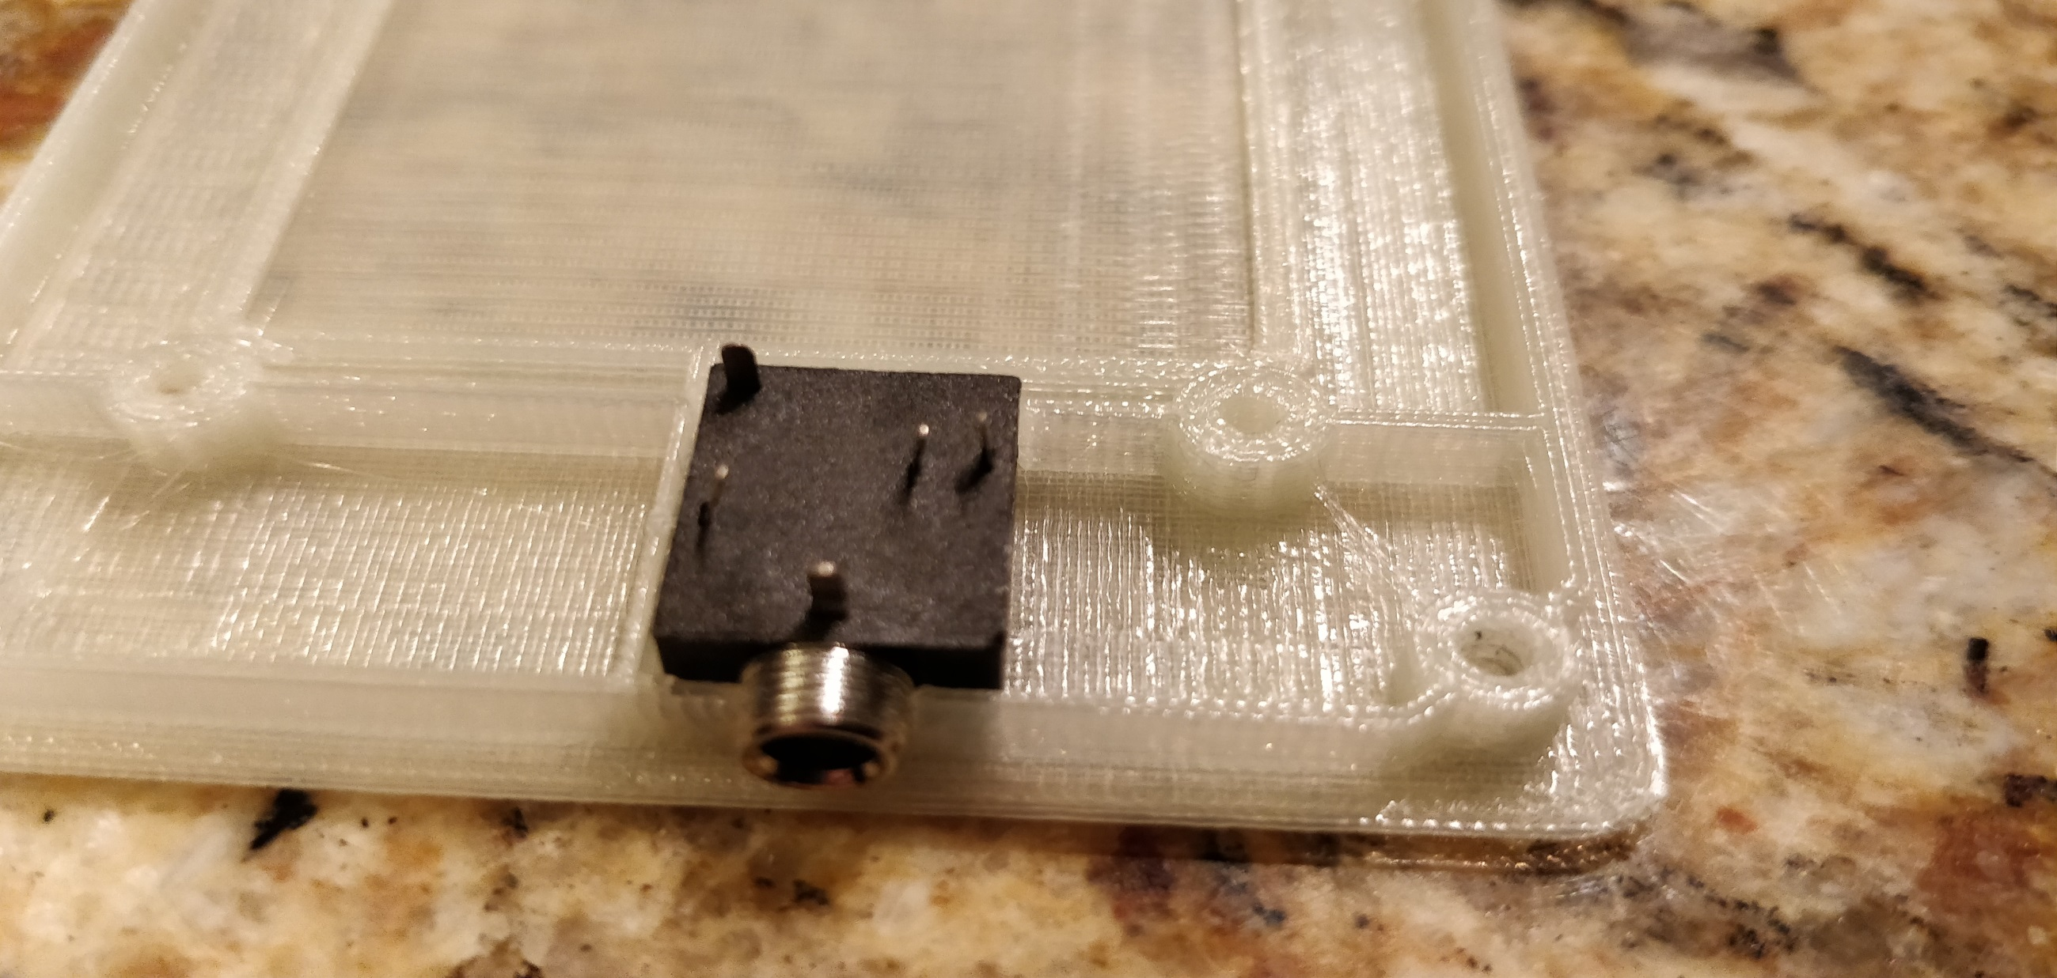

Slide 18
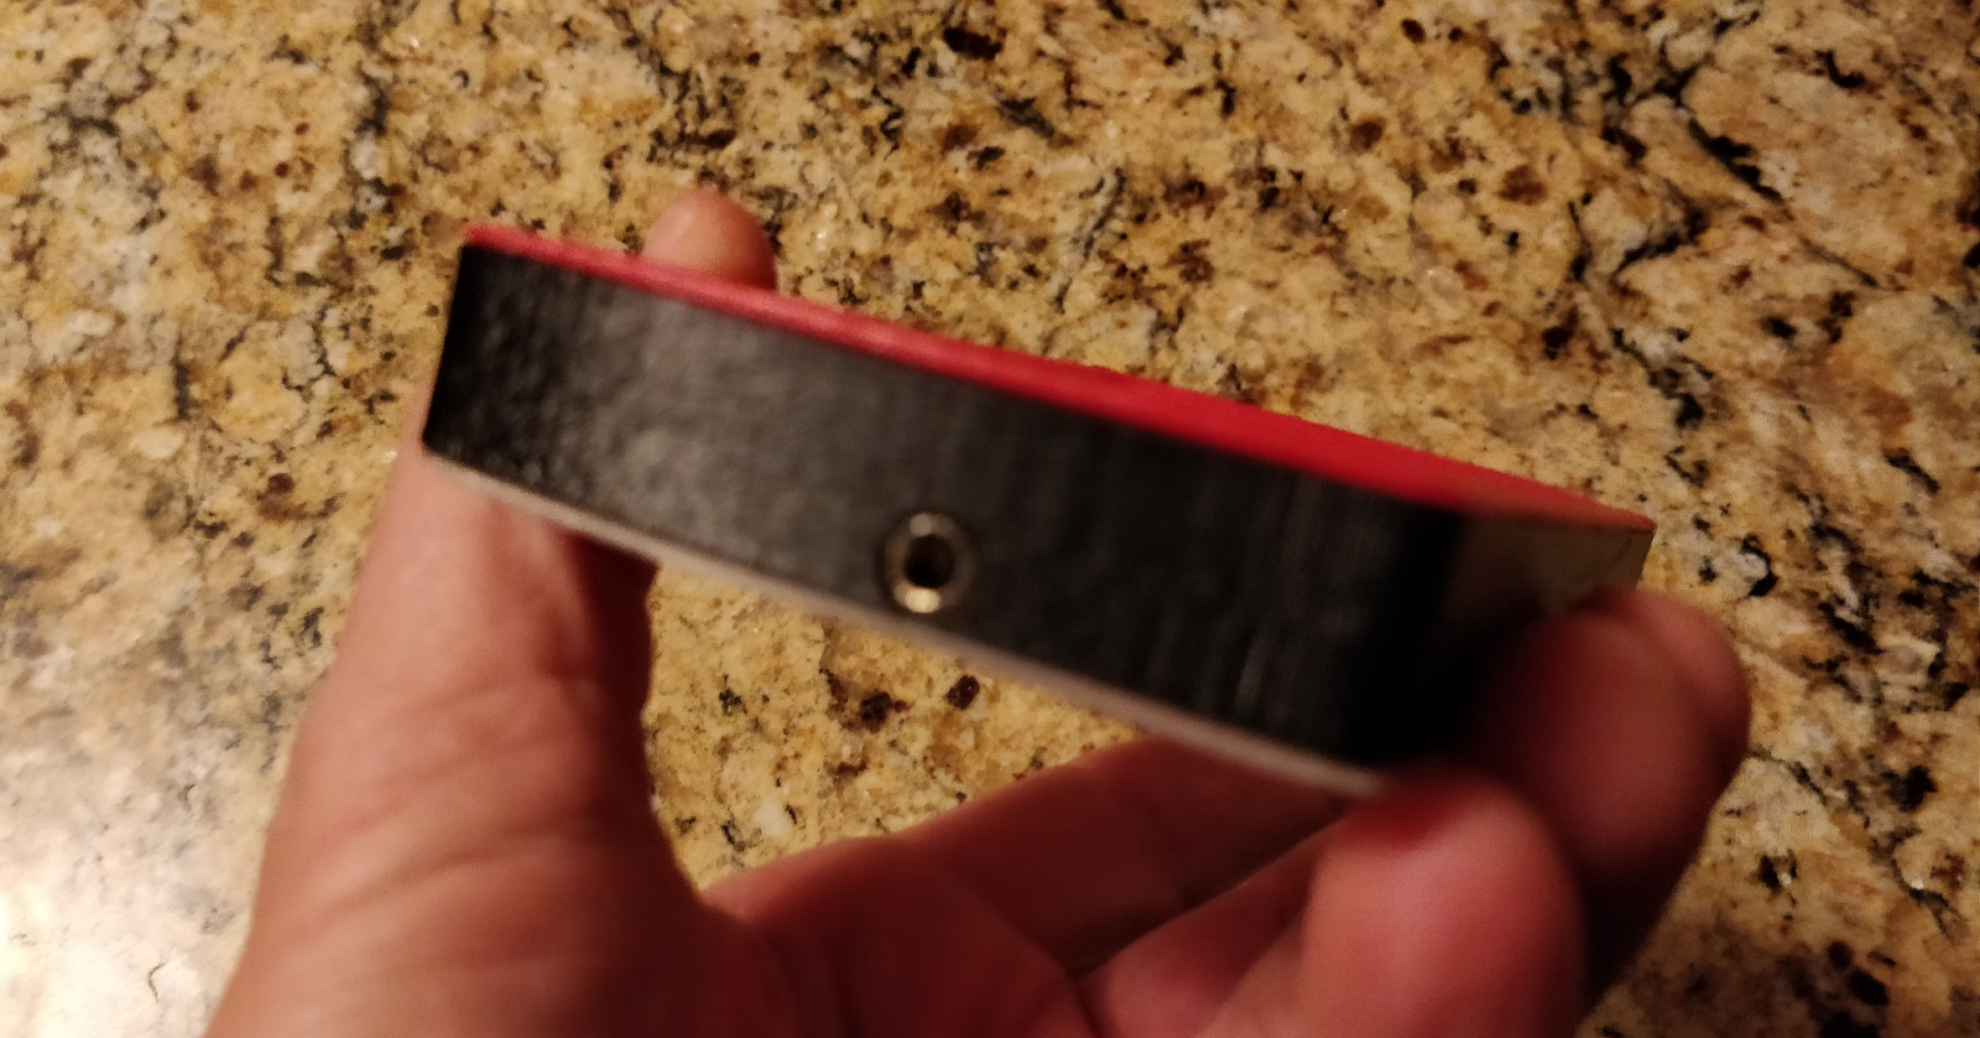

Slide 19
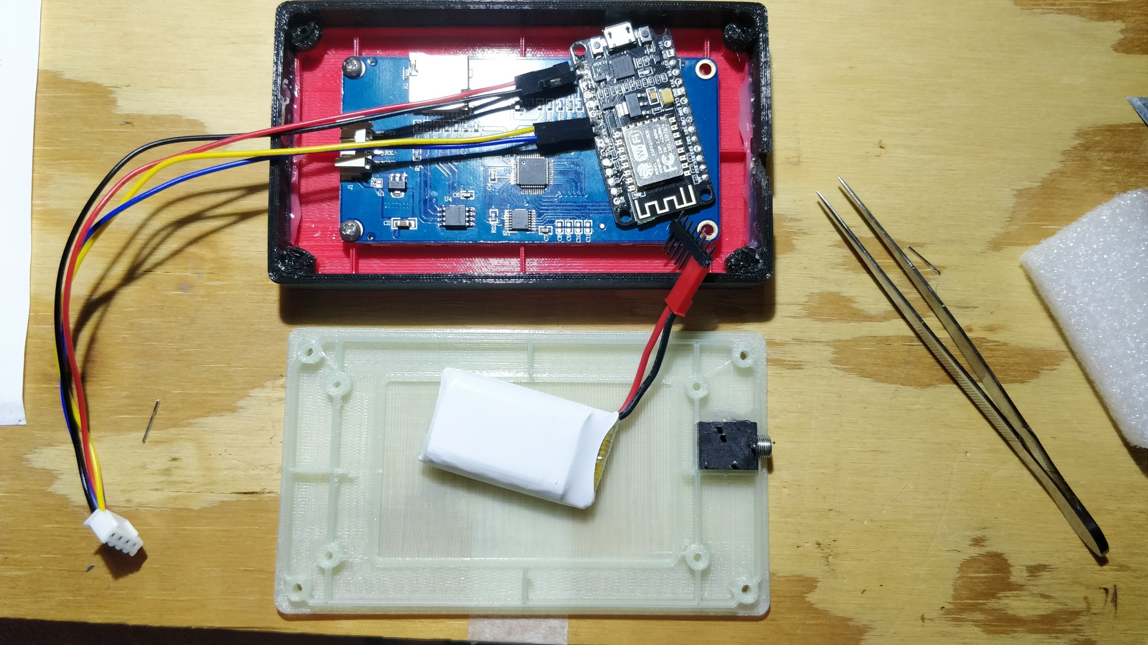

Slide 20
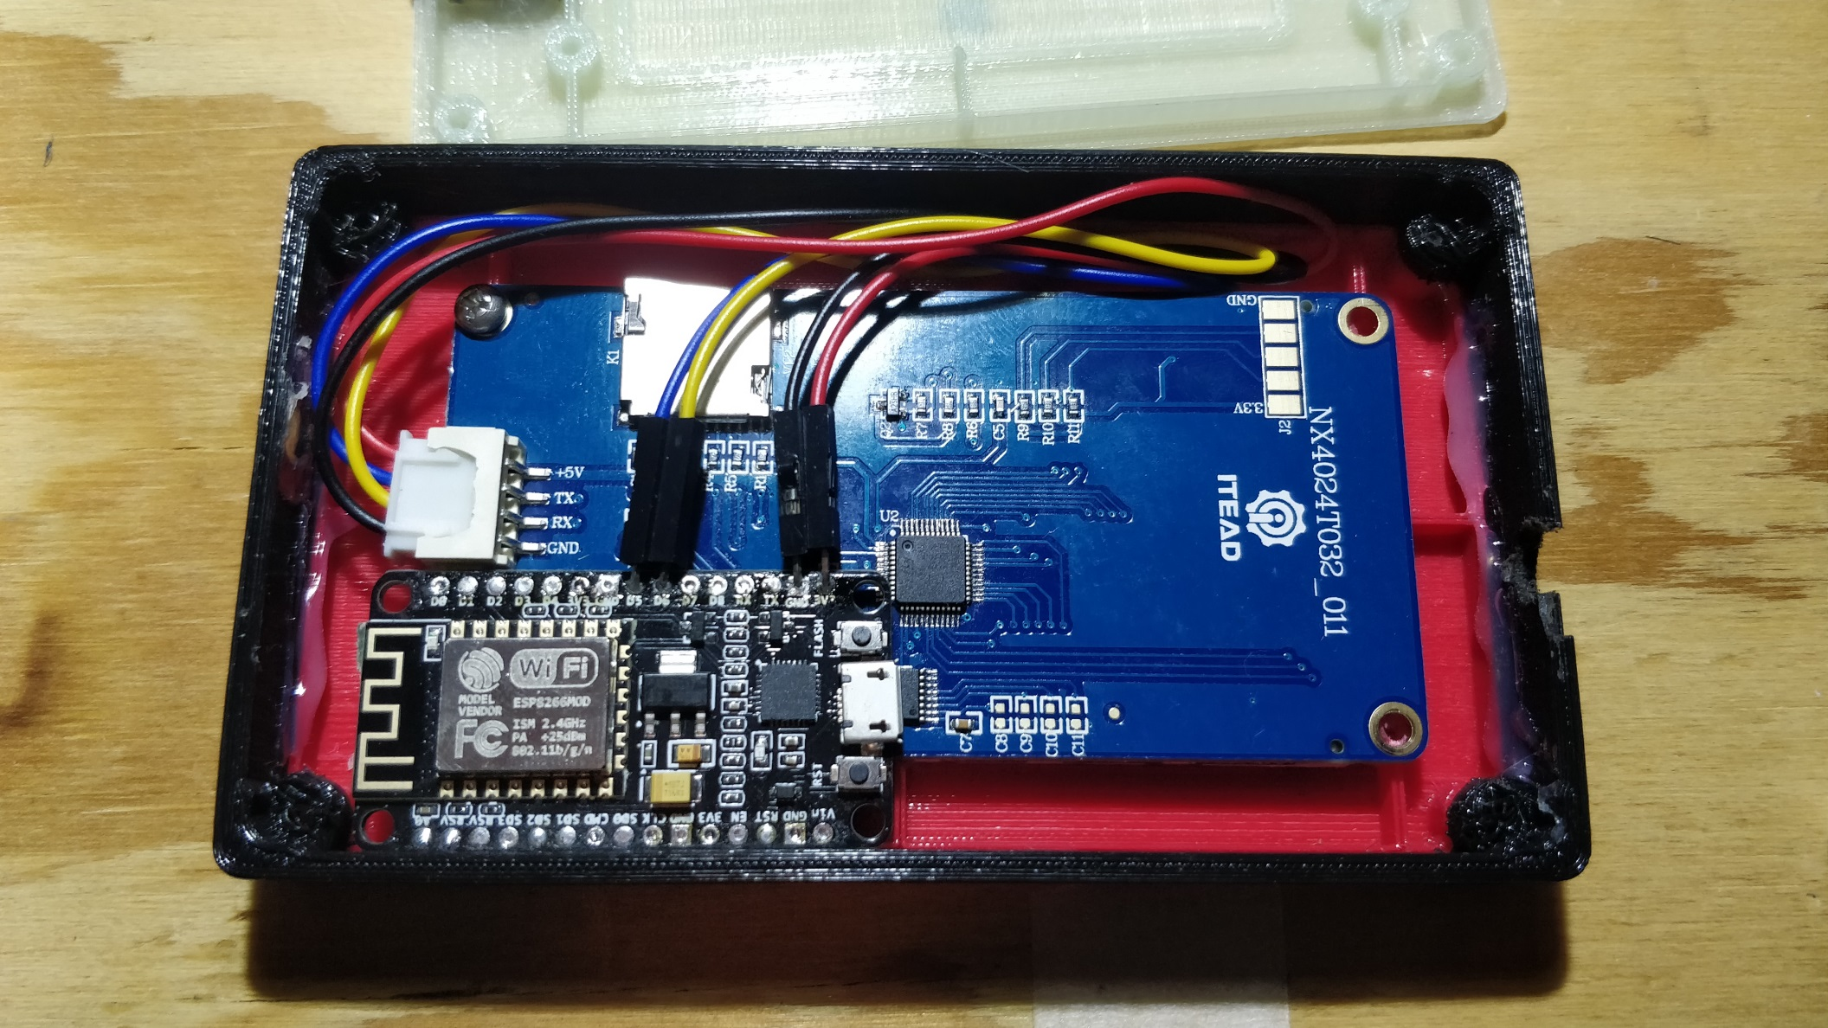

Slide 21
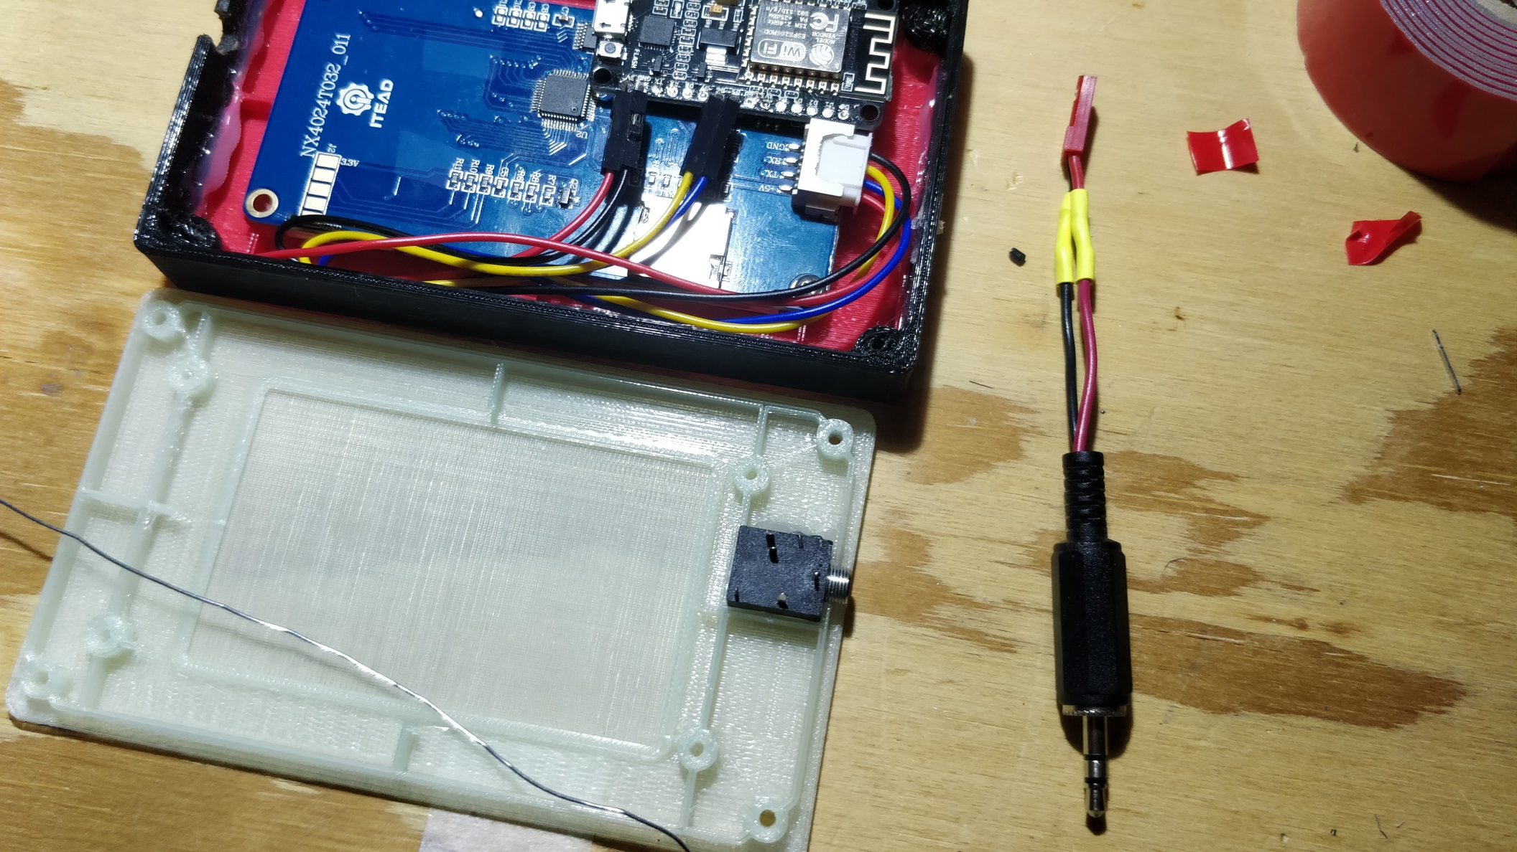

Slide 22
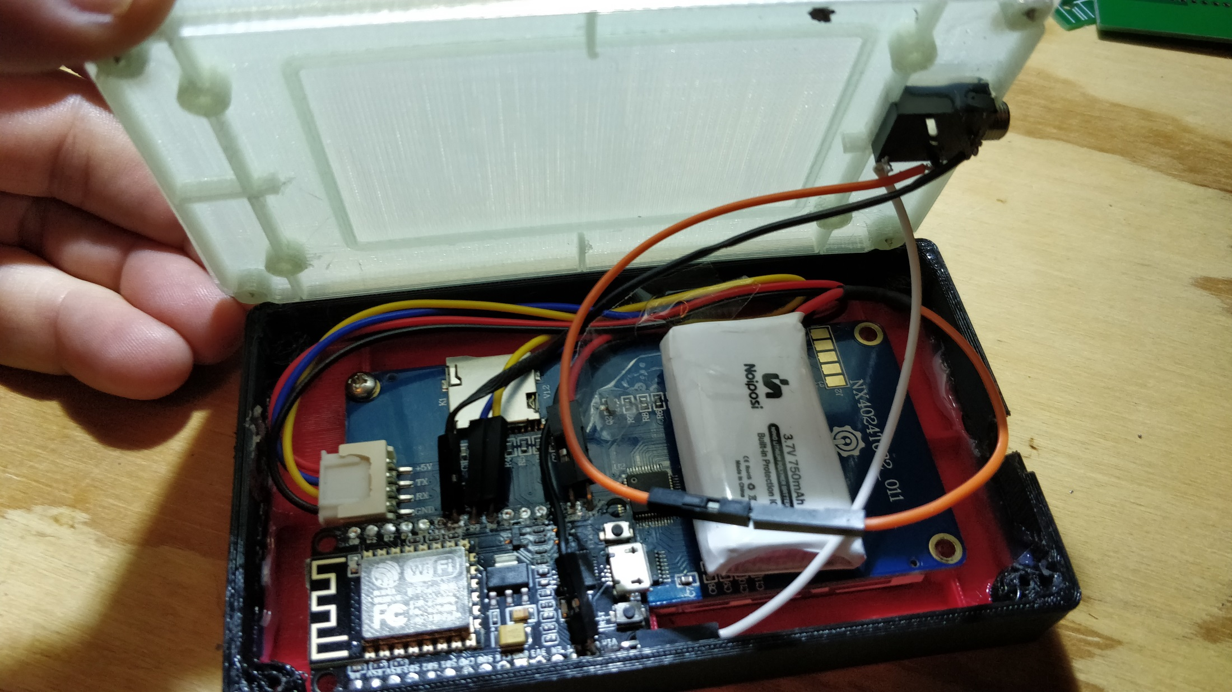

Slide 23
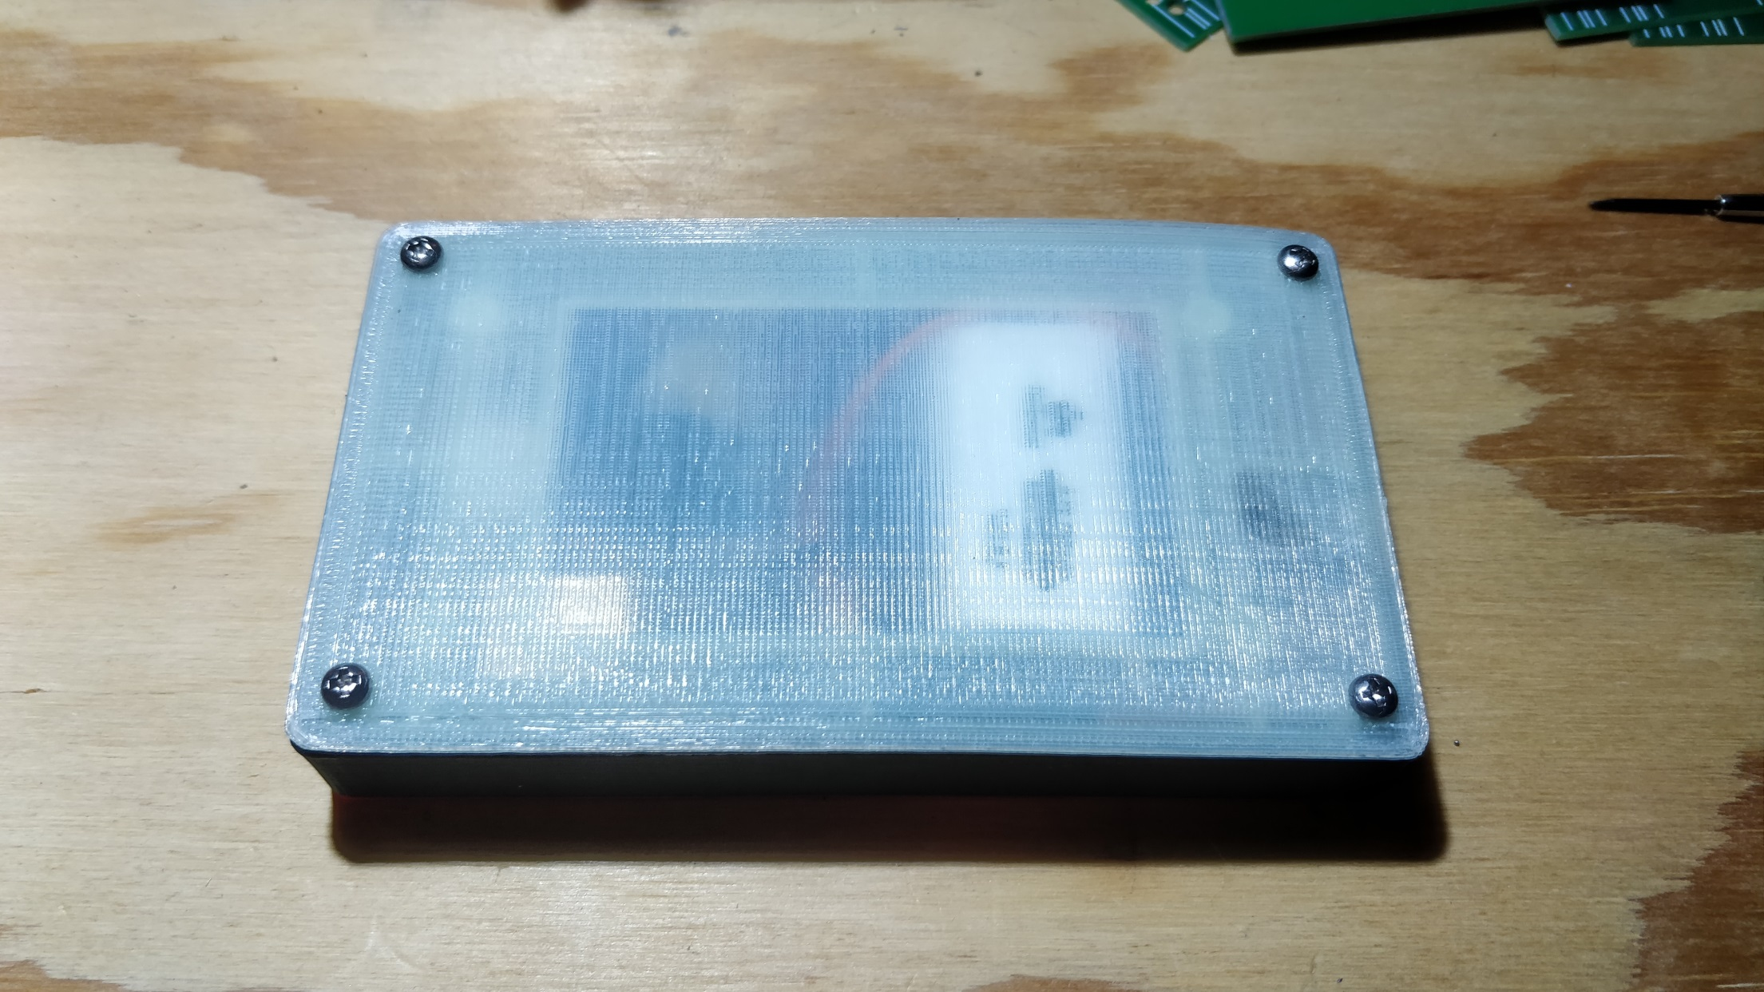

Slide 24
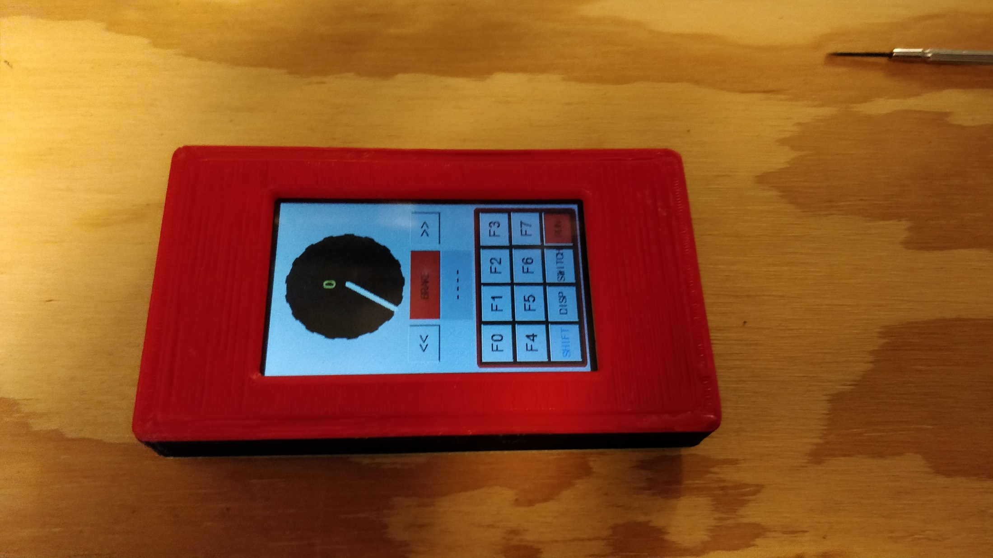

Slide 26
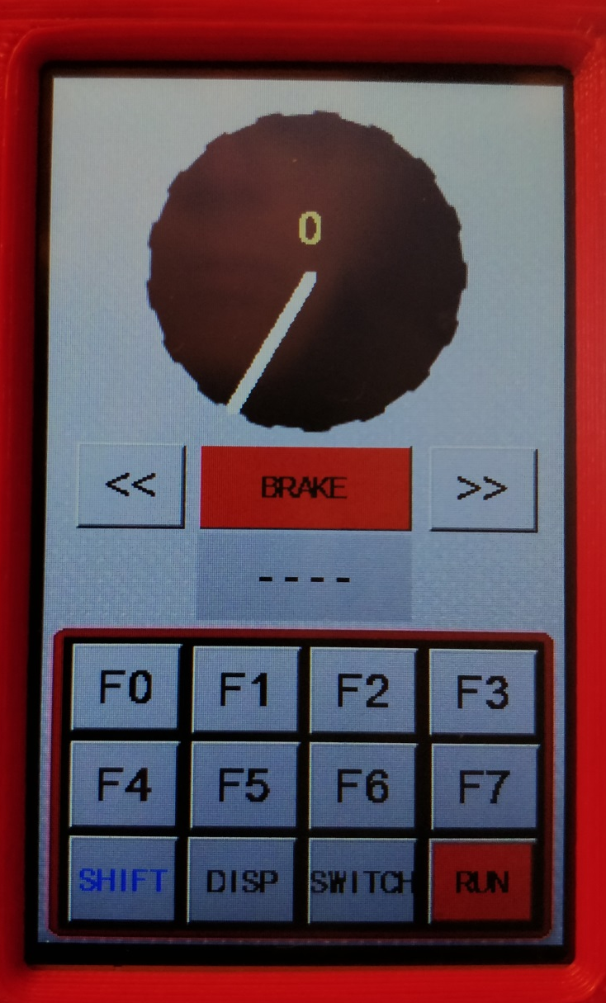
Speed Knob
Speed Indicator
Brake Button
Backward Selector
Forward Selector
Loco Address Display
Function Buttons
Disp Put Button
Mode Selector
Keyboard Shift
Run/Idle Selector

Slide 27
Press on Rim to set Target Speed
Current Speed Indicator
Press Brake Button to set 0 Speed Target
Hold for 500+ ms for immediate stop
Press to change Target Direction
Click to select Locomotive by Address
Click to activate / deactivate functions
Click to go to Switch or CTC boards
Click to switch function display to F8 – F15
Click to change Layout Power Status

Slide 28
Summary

Slide 29
Summary
Combining some cheap and readily available components allows for making a LocoNet WiFi throttle for pretty little money. I don’t know about you, but for me this generates appetite for more of the same

Slide 30
Summary
Combining some cheap and readily available components allows for making a LocoNet WiFi throttle for pretty little money. I don’t know about you, but for me this generates appetite for more of the same
Thanks to MQTT, the throttle works like any other LocoNet throttle. You can connect as many as you want.

Slide 31
Summary
Combining some cheap and readily available components allows for making a LocoNet WiFi throttle for pretty little money. I don’t know about you, but for me this generates appetite for more of the same
Thanks to MQTT, the throttle works like any other LocoNet throttle. You can connect as many as you want.
The Nextion display allows for making a surprisingly complex and fast user interface

Slide 32
Summary
Combining some cheap and readily available components allows for making a LocoNet WiFi throttle for pretty little money. I don’t know about you, but for me this generates appetite for more of the same
Thanks to MQTT, the throttle works like any other LocoNet throttle. You can connect as many as you want.
The Nextion display allows for making a surprisingly complex and fast user interface
Using a 3D printer to make a case is a very flexible and effective option for makers

Slide 34
https://www.banggood.com/3_2-Inch-Nextion-HMI-Intelligent-Smart-USART-UART-Serial-Touch-TFT-LCD-Screen-Module-p-1105286.html?rmmds=search&cur_warehouse=CN
https://www.banggood.com/6Pcs-ZOP-POWER-3_7V-750mAH-30C-1S-Lipo-Battery-JST-Plug-With-Charger-For-RC-Model-p-1329739.html?rmmds=search&cur_warehouse=CN
https://www.banggood.com/NodeMcu-Lua-WIFI-Internet-Things-Development-Board-Based-ESP8266-CP2102-Wireless-Module-p-1097112.html?rmmds=search&cur_warehouse=CN
Dispatch: http://www.digitrax.com/tsd/KB710/ut4-dispatch-a-locomotive-address/
Itead 3D Model: https://www.itead.cc/wiki/Nextion_HMI_Solution#3D_printing_bezel
Layout Intro Sequence: Beat Deola, Switzerland

